Slide 1

PENETRATION TESTING

Slide 2
Road Map
Types of Hackers
Dictionary attack and brute force attack. Passwords defense
Tools
Demo
Gitlab
QA

Slide 3

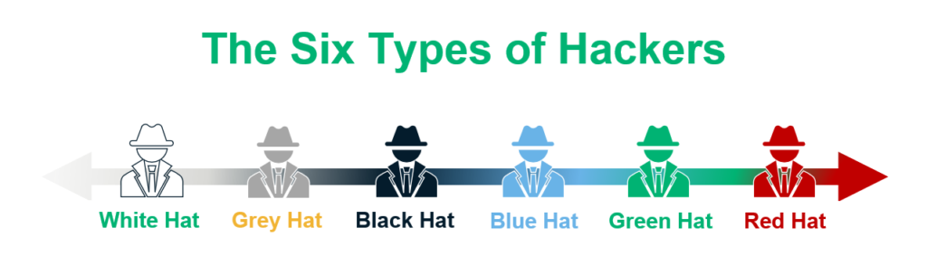
Types of Hackers
White Hat
Black Hat
Grey Hat
Blue Hat
Green Hat
Red Hat

Slide 4
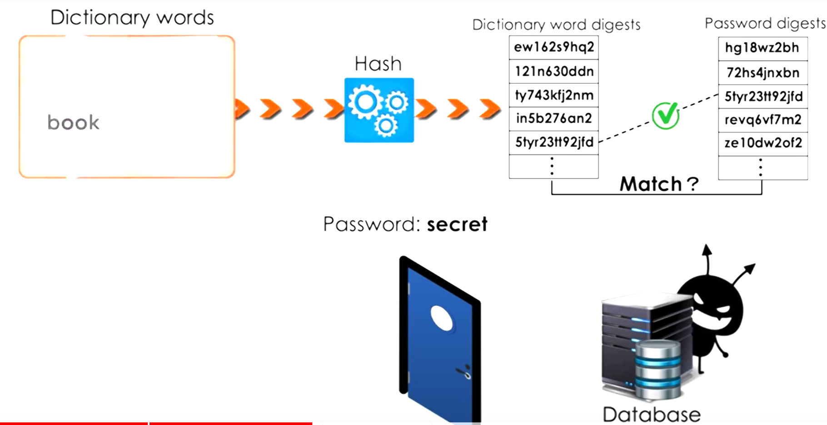
Dictionary attack and brute force attack
A dictionary attack attempts to systematically enter each word in the dictionary as a password until it finds a match. Countermeasures for dictionary attacks include enforcing a strong password policy and locking out access after a fixed number of unsuccessful attempts.

Slide 5
Passwords defense
Have a minimum length of 14 characters
Include at least one uppercase character
Include at least one lowercase character
Include at least one symbol
Include at least on numb
Can be reused after 24 password changes
Expire in 90 days
Multi-factor authentication (MFA)

Slide 6
TOOLS
Metasploit Framework - a tool for exploiting vulnerabilities in systems and applications.
Nmap - a network mapping tool used for identifying hosts and services on a network.
Wireshark - a network protocol analyzer used for capturing and analyzing network traffic.
Aircrack-ng - a tool for testing and analyzing wireless networks.
John the Ripper - a password cracking tool used for testing the strength of passwords.
Hydra - a password cracking tool used for brute force attacks on login credentials.
Sqlmap - a tool for detecting and exploiting SQL injection vulnerabilities in web applications.

Slide 7

Tools
Password cracking Tools
The name “John the Ripper” originated from a popular English language password cracking program named after the infamous 19th-century serial killer, Jack the Ripper.
The name “John the Ripper” was chosen as a play on words, with “John” being a common name and “ripper” referring to the program’s ability to “rip” passwords.
The program is designed to test the security of password-protected systems by attempting to crack the passwords using various techniques.

Slide 8
John The Ripper - a Penetration Testing tool
Crack passwords with -John the Ripper.
Penetration testing
It aims for locating security issues in specific information systems without causing any damage.
Pen tests are also occasionally known as white hat attacks because it involves a benevolent party’s attempt to break into a system.
If you are a pen-tester, cracking passwords is something you will be doing on a daily basis. This can include login passwords, file passwords, and almost anything that is protected using a password.

Slide 9
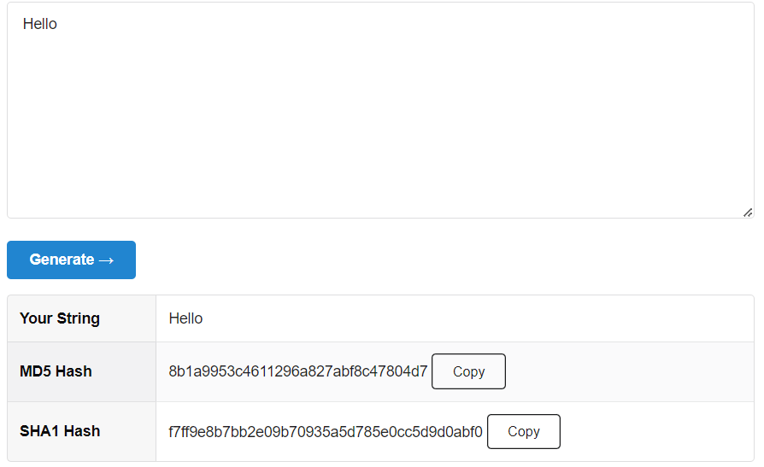
How to Crack Passwords using John The Ripper
Password Generator - MD stands for Message Digest. MD5 is a hashing algorithm that produces a 128-bit hash value.
SHA1 Secure Shell Algorithm generates a message digest of 160-bit hash value
*https://www.md5hashgenerator.com/
John The Ripper -
Single crack mode
john --single --format=raw-MD5 crack.txt
john --single --format=raw-sha1 crack.txt
Wordlist mode
john --wordlist=/usr/share/wordlists/rockyou.txt --format=raw-MD5 crack.txt
Incremental mode
john -i:digits passwordfile.txt

Slide 10
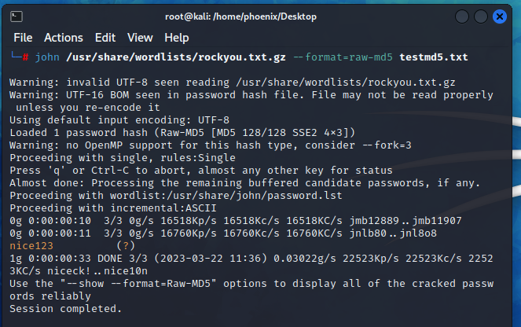
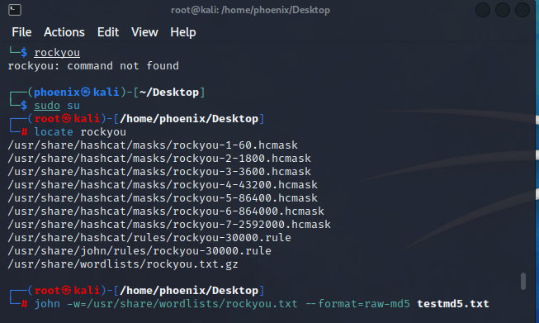
Demo

Slide 11
Hacking techniques
Phishing
Packet Sniffing
Social Engineering
Brute force attack

Slide 12
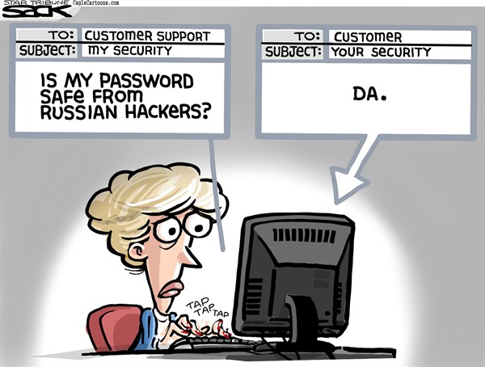
Q&A

Slide 13
Resources
John the Ripper - usage examples. Openwall. (n.d.). Retrieved March 23, 2023, from https://www.openwall.com/john/doc/EXAMPLES.shtml
Kumar, V. (2022, May 24). How to use Rockyou Wordlist in Kali Linux guide for beginner. CyberPratibha. Retrieved March 23, 2023, from https://www.cyberpratibha.com/blog/how-do-i-use-rockyou-wordlist-txt-in-kali-linux/
pwnhub. (2022, July 17). Password cracking - john the ripper | cracking MD5 hashes. YouTube. Retrieved March 23, 2023, from https://www.youtube.com/watch?v=h_cxbMuHAfE&t=138s
HackerSploit. (2018, February 18). Password cracking with john the ripper - RAR/zip & linux passwords. YouTube. Retrieved March 23, 2023, from https://www.youtube.com/watch?v=XjVYl1Ts6XI
Anonymous World. (2021, September 23). How to use john the ripper | kali linux. YouTube. Retrieved March 23, 2023, from https://www.youtube.com/watch?v=uAPKv9AcmzU
Shivanandhan, M. (2022, November 17). How to crack passwords using john the ripper – pentesting tutorial. freeCodeCamp.org. Retrieved March 23, 2023, from https://www.freecodecamp.org/news/crack-passwords-using-john-the-ripper-pentesting-tutorial/
https://www.itpro.com/security/34616/the-top-password-cracking-techniques-used-by-hackers

